Slide 1
I211 – Information Infrastructure II
Lecture 15

Slide 2
Tables.cgi (Group Work)
Write a CGI script that uses Python to print out an HTML table with 10 Rows and 8 Columns.
For an example of what yours should look like, go here:
http://cgi.soic.indiana.edu/~johfdunc/cgi_tables.cgi
Make sure you could easily change the program to print out a different size of table!

Slide 3
Tables.cgi (Solution)
#! /usr/bin/env python
print 'Content-type: text/html\n'
text = """
<html>
<head><title>Tables in CGI</title></head>
<body>
<h1>Your table should look like this:</h1>
<table border="1">
"""
for i in range(10):
text += "<tr>"
for j in range(8):
text += "<td>Row " + str(i+1) + ", Col " + str(j+1) + "</td>"
text += "</tr>"
text += """
</table>
</body>
</html>
"""
print text

Slide 4
HTML Forms and CGI
We can get input from users online by using HTML forms!
These have the same sorts of elements as Tkinter:
Text boxes <input type="text" name="name" />
Radio buttons <input type="radio" name="y_or_n" value="yes" checked /> Yes
Text areas <textarea name="comments" rows="3">None</textarea>
Buttons <input type="button" value="Push Me!" />
Check boxes <input type="checkbox" name="size" value="Large" /> Large

Slide 5
HTML Forms and CGI
HTML form elements must be enclosed in <form> tags.
The <form> tag has an action attribute that specifies what URL to send the data to:
<form action="send_to.cgi" method="post">

Slide 6
HTML Form elements
You don’t need to chmod HTML files!
<form action="send_to.cgi" method="post">
Name: <input type="text" name="name" /><br />
Username: <input type="text" name="user" /><br />
Password: <input type="password" name="pwd" /><br />
<input type="button" value="Push Me!" /><br />
Student Type: <br />
<input type="radio" name="s_type" value="ugrad" checked /> Undergraduate<br />
<input type="radio" name="s_type" value="grad" /> Graduate<br />
Language: <br />
<input type="checkbox" name="language" value="English" /> I speak English<br />
<input type="checkbox" name="language" value="Other" /> I speak another language<br />
Comments: <br />
<textarea name="comments" rows="3">None</textarea><br />
<input type="submit" value="Submit" />
<input type="reset" value="Reset All" />
</form>
A submit input is a special button that submits the form when clicked!

Slide 7
Simpler Form
<html>
<head><title>First Interactive Form</title></head>
<body>
<form action="name.cgi" method="post">
Please enter your name:
<input type="text" name="name" /><br />
<input type="submit" value="Submit" />
</form>
</body>
</html>
Save this as name.html and upload it

Slide 8
Form CGI Handler
#! /usr/bin/env python
print 'Content-type: text/html\n'
import cgi
form = cgi.FieldStorage() #parses form data
html = """
<html>
<head><title>Form in CGI</title></head>
<body>
<h1>Greetings!</h1>
<hr>
<p>%s</p> #says we’ll insert this value later
<hr>
</body>
</html>
"""
if not 'name' in form: #triggers if name was blank!
print html % 'Who are you?'
else:
print html % ('Hello, ' + form['name'].value) #gets the value of the name input
Save this as name.cgi, and don’t forget to chmod 755 it!

Slide 9
HTML Forms and CGI
import cgi
form = cgi.FieldStorage()
form now has a dictionary-like object where the form element’s name attribute is the key, and the form element’s data (user-typed or value attribute) is the value
If you print it out, this is what you’ll get:
FieldStorage(None, None, [MiniFieldStorage('name', 'J')])

Slide 10
HTML Forms and CGI
HTML Forms:
http://www.w3.org/TR/html4/interact/forms.html
http://www.w3schools.com/html/html_forms.asp
Python CGI:
http://docs.python.org/library/cgi.html
http://webpython.codepoint.net/cgi_tutorial

Slide 11
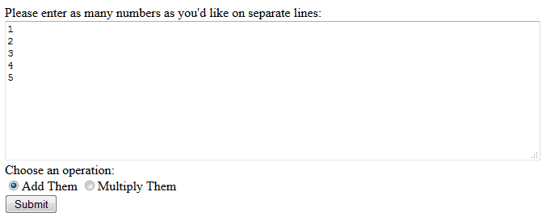

Calculate (Group Work)
Write an HTML form and a Python CGI script that does this:
HTML Form
Python CGI Script

Slide 12
Calculate (HTML Solution)
Live version: http://cgi.soic.indiana.edu/~johfdunc/calculate.html
<html>
<head><title>Calculate</title></head>
<body>
<form action="calculate.cgi" method="post">
Please enter as many numbers as you'd like on separate lines: <br />
<textarea name="numbers" rows="10" cols="80"></textarea><br />
Choose an operation: <br />
<input type="radio" name="operation" value="add" checked>Add Them
<input type="radio" name="operation" value="mult">Multiply Them<br />
<input type="submit" value="Submit" />
</form>
</body>
</html>

Slide 13
Calculate (Python Solution)
if not 'numbers' in form or not 'operation' in form:
print html % 'No data entered or no operation chosen!'
else:
numbers = form['numbers'].value
numbers = numbers.split('\r\n')
for num in numbers:
num = num.strip()
the_sum, the_prod = add_mult(numbers)
if form['operation'].value == 'add':
print html % ("The sum is: " + str(the_sum))
else:
print html % ("The product is: " + str(the_prod))
calculate()
#! /usr/bin/env python
print 'Content-type: text/html\n'
def add_mult(nums):
total_sum = 0
product = 1
for num in nums:
total_sum += float(num)
product *= float(num)
return total_sum, product
def calculate():
form = cgi.FieldStorage()
html = """
<html>
<head><title>Calculate</title></head>
<body>
%s
</body>
</html>
"""

Slide 14
Questions?

